Slide 1


November 2022
Introductory Presentation
Disrupting Chronic Disease with Rare Hemp Polyphenols

Slide 2
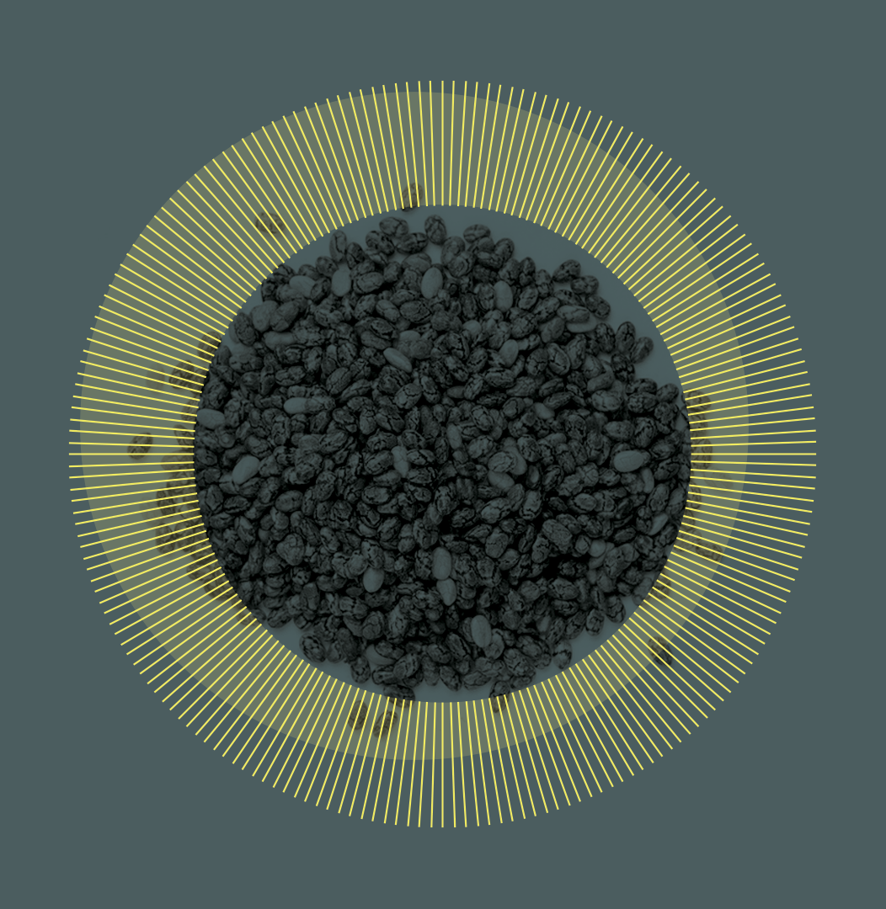
Our Mission
Canurta is a growing biotech pioneering the production of safe, effective and novel cannflavin-rich ingredients from hemp polyphenols for a spectrum of human and animal diseases in the food, wellness and biopharma sectors.
Our mission is to solve the world’s biggest health challenge: preventing, managing and treating chronic disease safely and effectively.
We build natural solutions backed by science to rival drug and natural alternatives that often do more harm than good, or don't do enough.
Notes:
We’re on a miss

Slide 3

Our Reason
The sad fact is that the failures of mainstream therapeutics have led to a chronic disease crisis.
Standard of care treatments such as pharmaceuticals carry dangerous side effects while botanical solutions are generally less effective.
73%
60%
$43T
Of global deaths
Of global disease burden
Economic impact by 2050
Notes:
https://www.rand.org/blog/rand-review/2017/07/chronic-conditions-in-america-price-and-prevalence.html

Slide 4
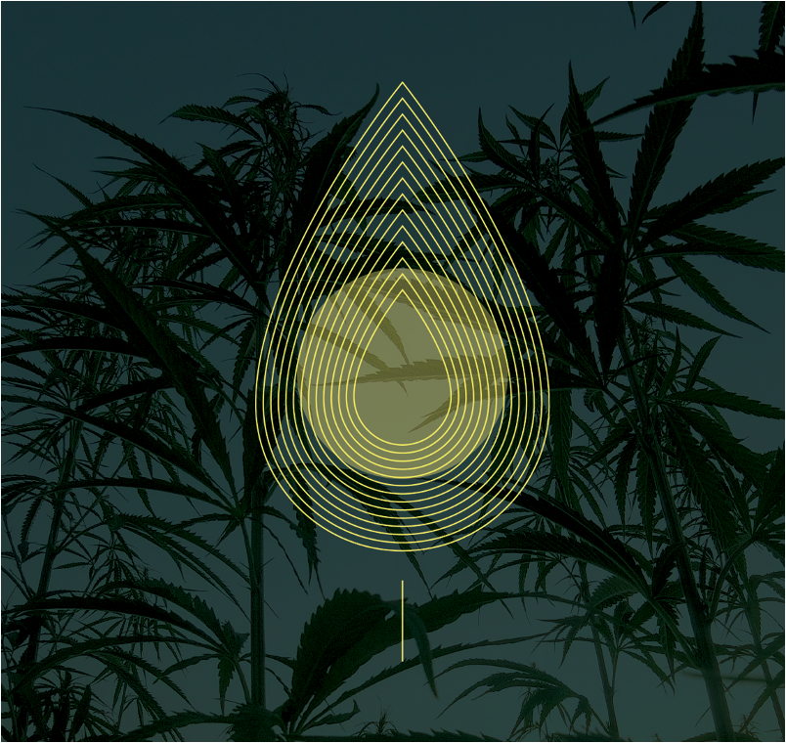
Our Molecules
Despite the economic boom surrounding cannabis, clinical trials for cannabinoids like CBD do not represent the therapeutic potential of other, more effective bioactive compounds unique to hemp.
Canurta focuses on rare non-cannabinoid, non-psychoactive polyphenols called Cannflavins. Present in less than <0.01% of the plant, these polyphenols have been hard to access via traditional methods - until now.
From the plant to lab, Canurta has developed 3 innovative ways to produce cannflavin-rich polyphenol products, each with their own patent filing.
Nature’s Synergy
No dangerous side effects, no toxicity
New First-line Therapy
Early intervention superior to other treatments
Address Root Cause
Proven to inhibit disease mediators at the source
Backed by Science
Supported by robust clinical pipeline
Confidential – Do not duplicate or distribute without written permission from Canurta Inc.

Slide 5



Our Values
Environmental
Social
Governance
Local and sustainable procurement practices
Energy-efficient manufacturing processes
Waste reduction through upcycling of waste hemp biomass and reuse of key inputs
Green packaging and shipping
ESG-oriented partnerships
Reduction, replacement and refinement in R&D to protect animal welfare
Certified carbon negative NFTs accredited by Nori
Economic enhancement for local agricultural communities
Ongoing investment in R&D to prevent and treat chronic diseases
Safe, natural and affordable products with applicability across patient groups
New job creation in manufacturing and R&D, particularly for women, students and underrepresented populations
Ethical and fair employment practices
Data ownership and transparency
Shareholder engagement and rights protection
Law and regulation compliance in countries of operation and other international mandates
Prohibition of corruption and bribery
RIsk identification, reduction and management
Productivity management through regular monitoring and reporting of internal processes
Annual executive and directorial evaluation
Confidential – Do not duplicate or distribute without written permission from Canurta Inc.

Slide 6

A JOURNEY TO BETTER HEALTH

Slide 7

OUR MISSION //001
001
The Healing Project is a community of early adopters for Canurta’s innovative, safe and effective solutions. By joining the community, you will be supporting Canurta’s development and have first access to our products as we release them.
Our aim with The Healing Project is to bring together supporters of Canurta’s innovations to engage further and access more.

Slide 8
The Healing Project is a Canurta funded community to build meaningful culture and projects around science, technology and the environment. By joining the community, you will be able to contribute to these projects and have first access to Canurta products as we release them.
Our aim with the The Healing Project is to bring together a community of like minded individuals to engage and access more with Canurta.

Slide 9

ENGAGE //002
002
Canurta is developing multiple community projects, and our Xilas Syndicate story is at the forefront.
We want our community members to gain early access, participate, and provide feedback as we develop these projects to support our main Canurta products.
In addition, we’re committed to helping those in need by using 1% of the revenue generated by Canurta to support a charity of our community’s choice.

Slide 10

ACCESS //003
003
Joining gives inside access to Canurta’s research and development with updates through our exclusive community. Gain transparency into our research and learn more about what we’re doing to ensure we produce the highest quality products.
As we develop our products, our community will be the first to access them directly from Canurta. This allows for greater savings for the people that support us as we develop our solutions with high precision.

Slide 11

THE XILAS SYNDICATE //004
004
The Xilas Syndicate Story is our first major community project. The Healing Project aims to bring stories to life to help build a culture around the pursuit of science, technology and the environment.
By collaborating and getting feedback from our community, we will bring our story to life. While we continue to build and develop, here is a teaser of what’s to come.

Slide 12

ORIGIN STORY //005
005
21-year-old Leon Velasco is a university student at Arcadia University and has grown tired of Sonhe Inc.’s dangerous pain-killing solutions. His research into the Xilas plant is not as straightforward as he’d planned.
Pursed and attacked by Sohne Inc., he’s pulled into an interstellar adventure of unknown proportions. Leon and his newly formed team, the Xilas Syndicate, must travel to a far-away planet in search of the catalyst to free people from addiction and suffering.

Slide 13
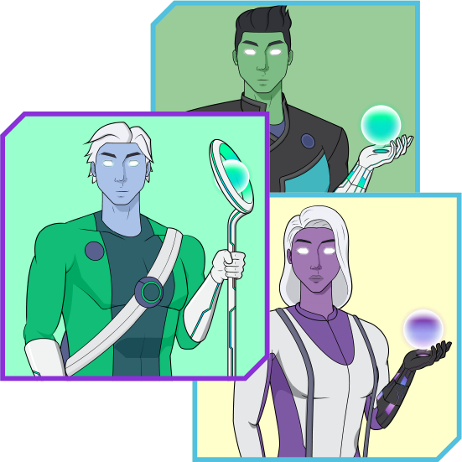
BECOME A MEMBER //006
006
Using blockchain technology, our memberships gain the ability to connect to various platforms and our websites with a simple web3 connect.
While our first story introduces the origin of how the Syndicate came to be, the art you receive when joining The Healing Project reflects the early concept art of the members recruited to the Xilas Syndicate after the origin story. They are on their journey to spread the power of Xilas across the earth and beyond.
When you join, you will receive your randomly selected Xilas Syndicate membership pass. This is your key and token to our community. The fight for a better tomorrow is here.
Join the mission today!

Slide 14
THANK YOU
Learn more at thehealingproject.xyz

